Slide 1
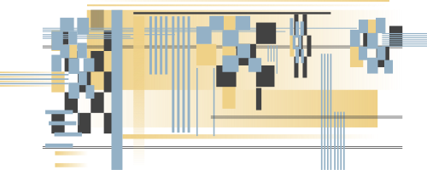
TEAM 2
2025
WEEKEND PHONE USAGE VS ACADEMIC PERFORMANCE
9th grade only
Xingyi Yao
Martin Campos Enriquez
Vania Ariadna De la Cruz Castillo

Slide 2

WEEKEND PHONE USAGE VS ACADEMIC PERFORMANCE
Many teenagers use their smartphones often, especially on weekends. This project explores whether using the phone too much can negatively affect school performance.
9TH GRADE ONLY

Slide 3
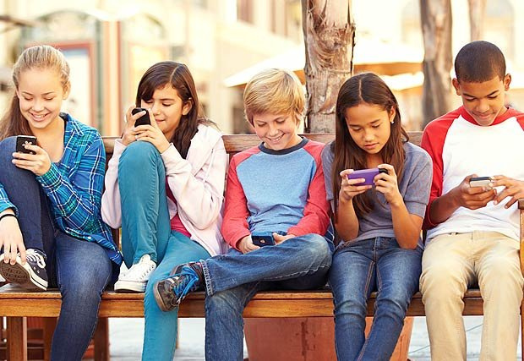


RESEARCH QUESTION
Do students who use their phones more on weekends get lower grades (GPA)?
HYPOTHESIS
PURPOSE
Students who spend more time on their phones will have lower grades.
Use basic statistics and graphs to find out if there's a connection between phone use and academic performance.

Slide 4
DATASET
Initially, 3,000 student records were available. Due to computational considerations, we analyzed the first 2,000 records.
Only students in the 9th grade were selected for this study to maintain a consistent academic level across all observations.
KEY
VARIABLES
Weekend_Usage_Hours
Measured using students’ GPA

Slide 5
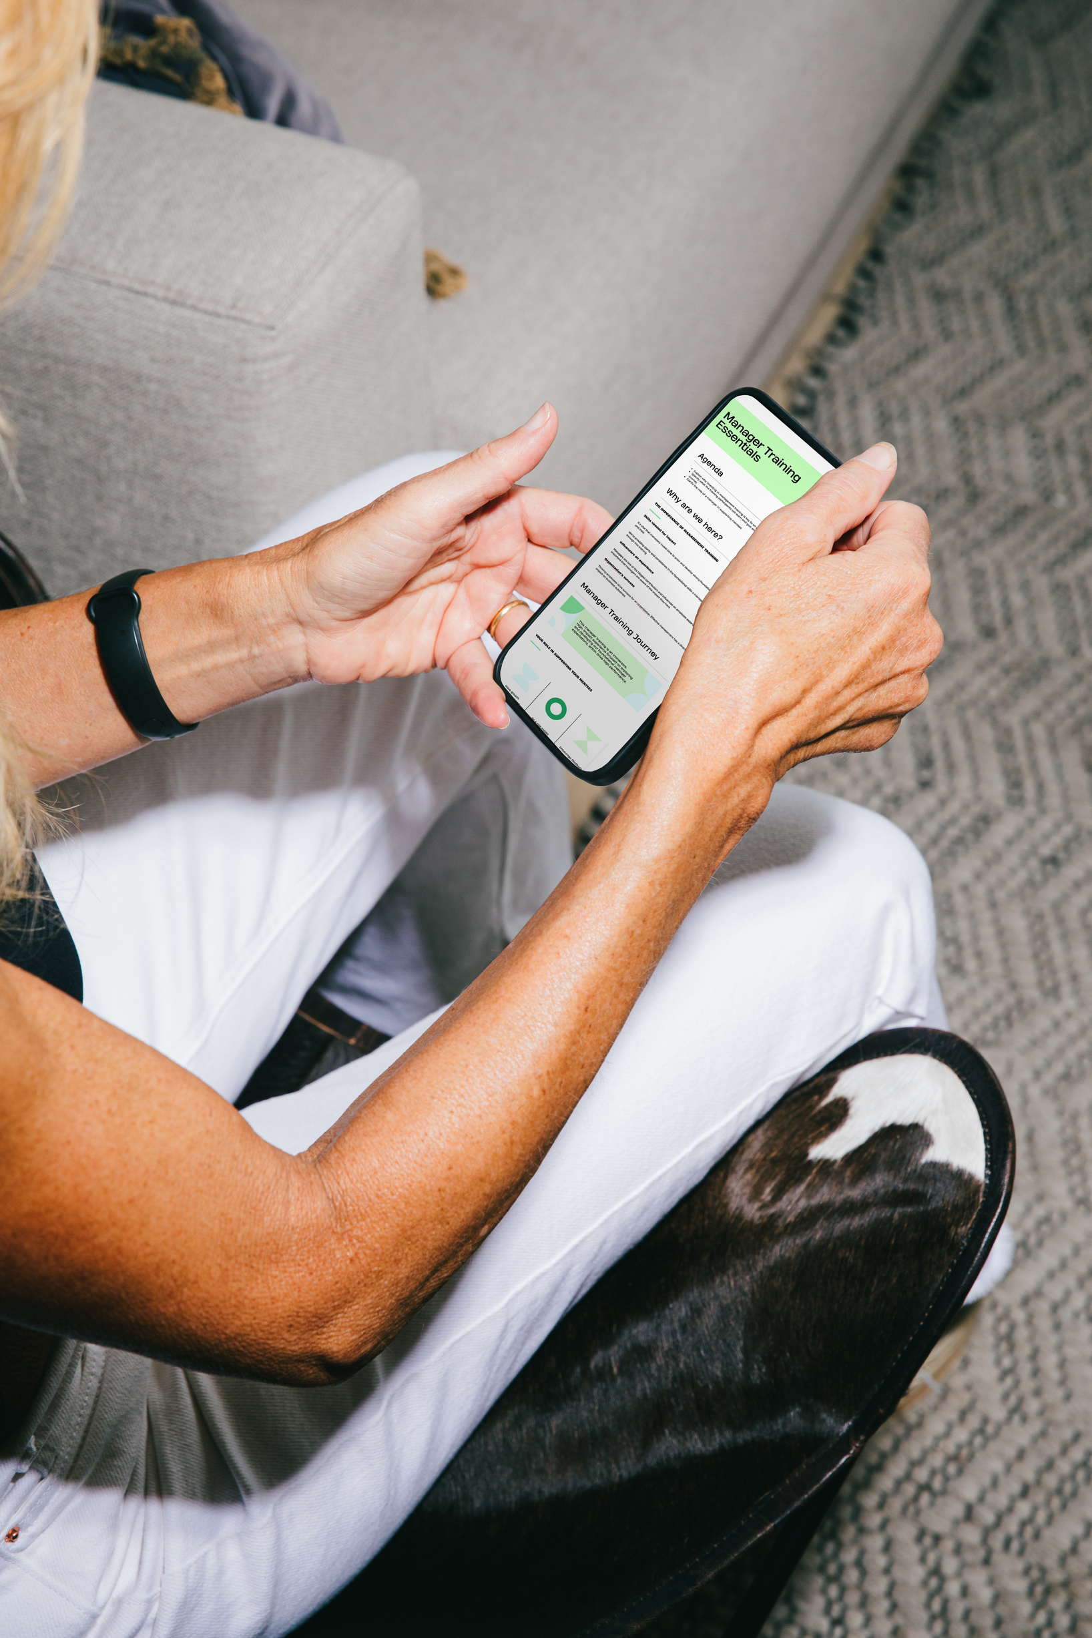
GROUP CLASSIFICATION
We calculated the median of weekend phone usage across all students. This value served as the threshold to create two groups:
High Usage Group: Students whose phone usage exceeds the median.
Low Usage Group: Students whose phone usage is at or below the median.

Slide 6
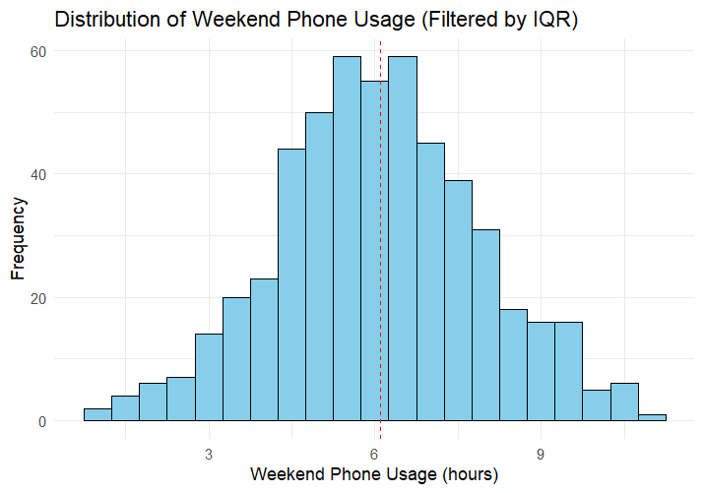
HISTOGRAM OF WEEKEND PHONE USAGE

Slide 7
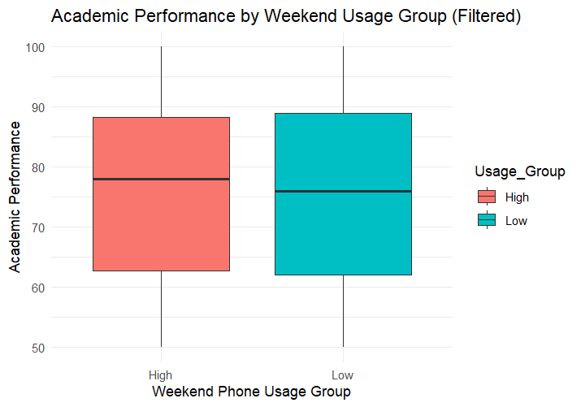
BOXPLOT OF ACADEMIC PERFORMANCE BY GROUP

Slide 8
BOXPLOT OF ACADEMIC PERFORMANCE BY GROUP

Slide 9
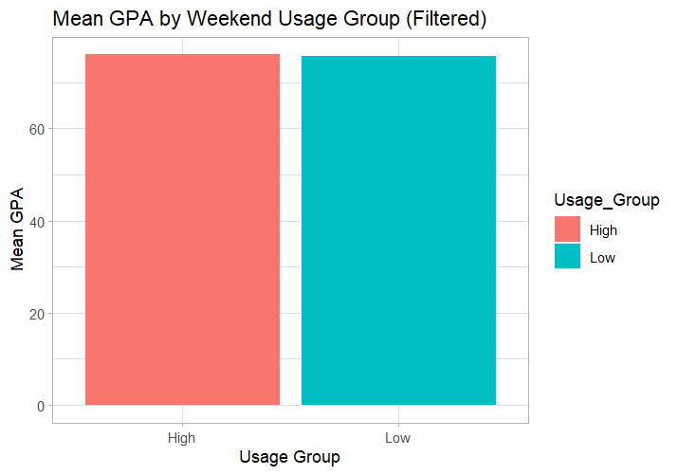
BAR CHART OF MEAN GPA BY GROUP

Slide 10
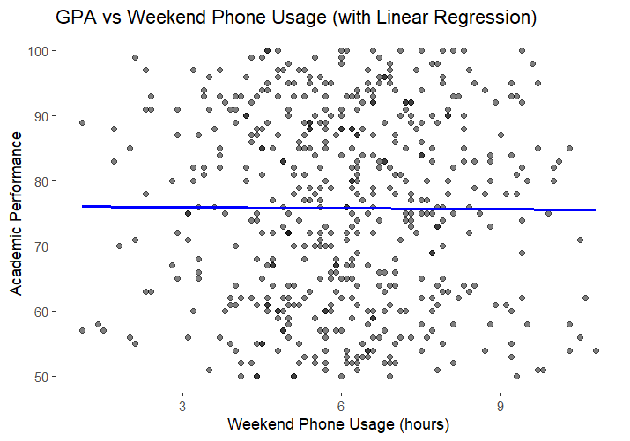
LINEAR REGRESSION
The line has a slightly negative slope, but very close to zero.
This means as phone usage increases, GPA barely changes.
There is high dispersion (spread) in GPA values at all phone usage levels.
The low slope suggests that weekend phone usage does NOT meaningfully predict GPA.

Slide 11
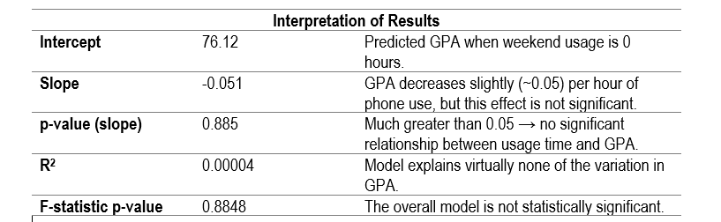
LINEAR REGRESSION
The linear regression model shows no significant relationship between weekend phone usage and academic performance (p = 0.885). The R² value is nearly zero, indicating that phone usage explains almost none of the variation in GPA.
Linear Regression Equation:
Academic_Performance =
76.12 − 0.05 × Weekend_Usage_Hours

Slide 12
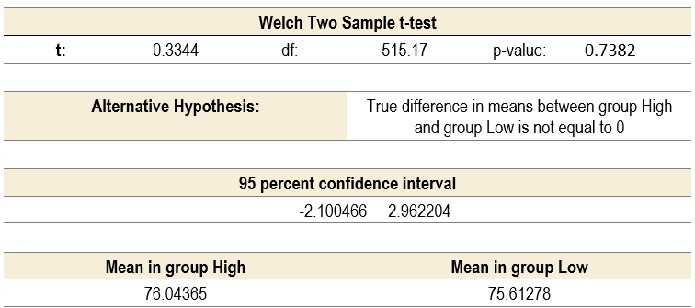
T-TEST RESULTS (HYPOTHESIS TESTING)
“There is no statistically significant difference in academic performance between the High and Low weekend phone usage groups”.
Test Applied: Two-sample t-test comparing GPA between High and Low Usage groups.
Since the p-value = 0.7264 is much greater than 0.05, we fail to reject the null hypothesis.
Null hypothesis (H₀): The mean GPA of High and Low usage groups is the same.
Alternative hypothesis (H₁): The mean GPA is different between the two groups.
"The t-test shows no significant difference in academic performance between students with high vs. low weekend phone usage (p = 0.7264), suggesting that phone use alone may not strongly affect GPA."
t-statistic: 0.35 (very close to 0)
95% Confidence Interval: [−2.08, 2.98]

Slide 13

CONCLUSIONS
The data does not support a significant relationship between weekend phone usage and academic performance. Both linear regression and hypothesis testing suggest that phone usage alone is not a meaningful predictor of GPA among 9th-grade students.

